Slide 1
Dynamic Weighted Majority
Elgun Majidov

Slide 2
Problem
Concept Drift - is an online learning task in which concepts change or drift over time.
Solution: Ensemble Methods
Ensemble methods maintain a collection of learners and combine their decisions to make an overall decision. G

Slide 3
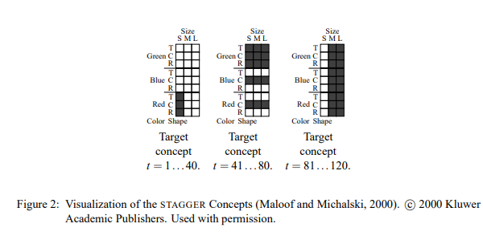
Data

Slide 4
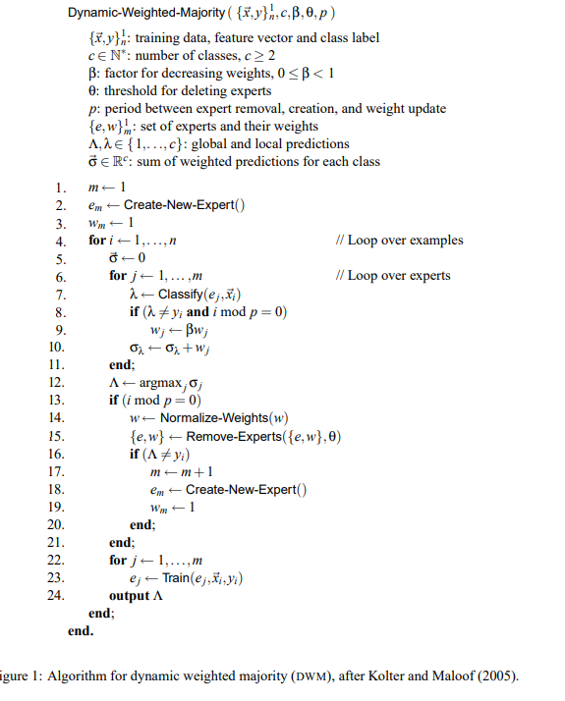
Related Work

Slide 5
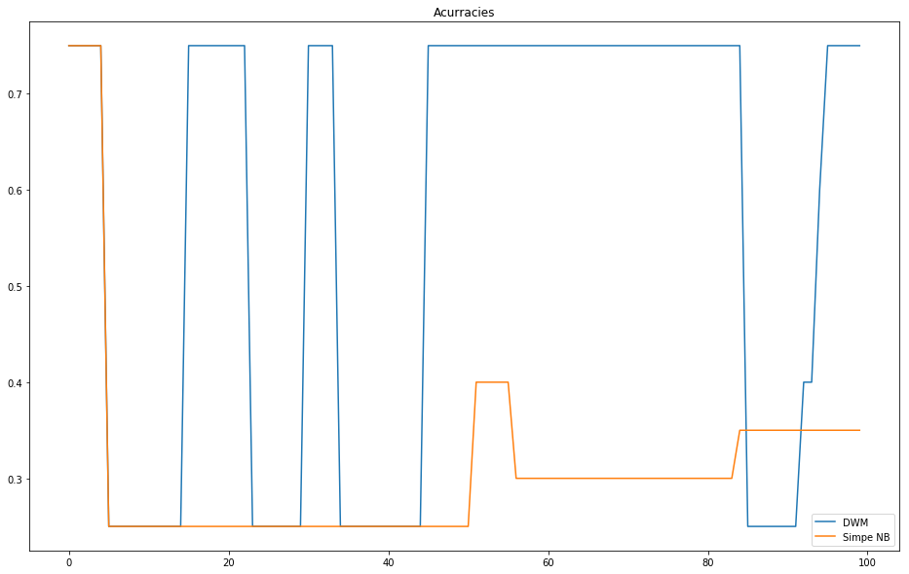
Results: period = 5

Slide 6
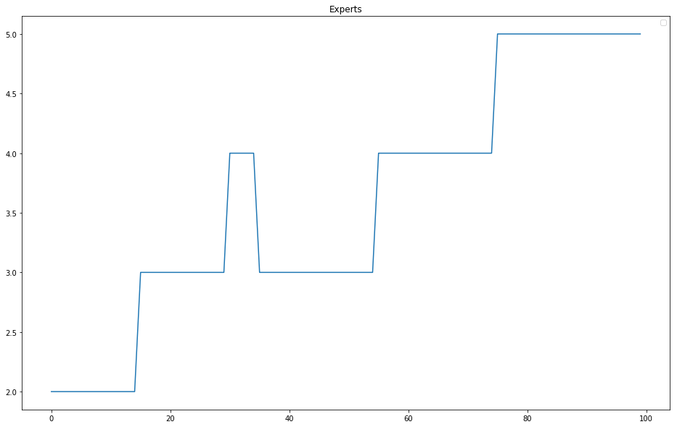
Results: number of experts

Slide 7
Accuracy on new data
Naïve Bayes: 0.69
DWM: 0.71

Slide 8
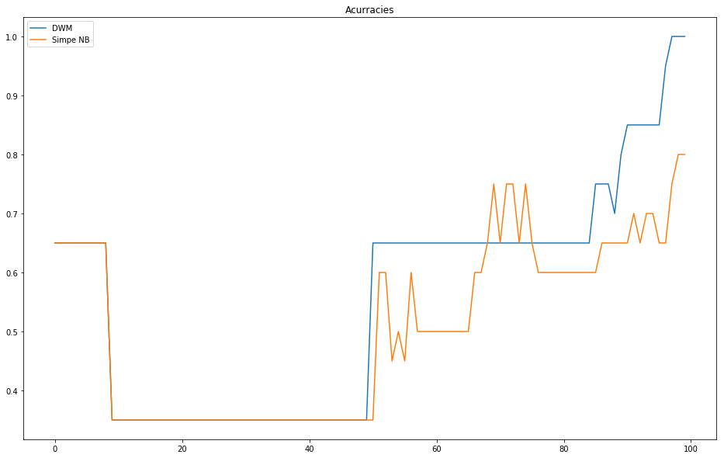
Test with each sample of data

Slide 9
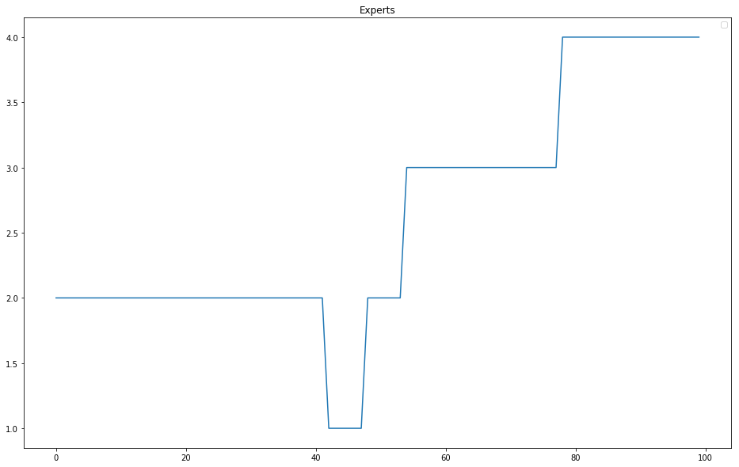
Test with each sample of data

Slide 10
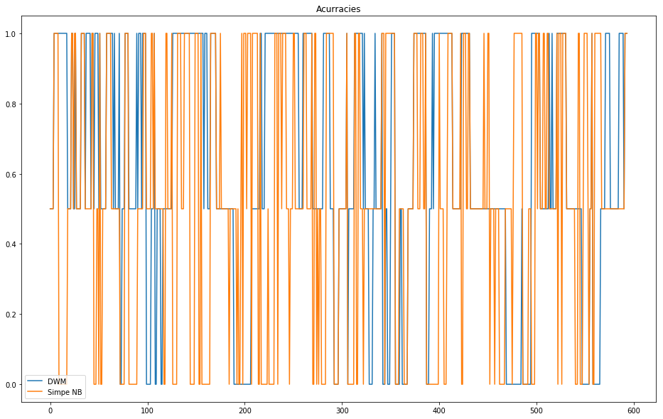
Sea Concept

Slide 11
Thank you ☺

